Slide 1
QSYS – ATS Database Management System
ACR Unit

Slide 2
Background information (from other presentations)

Slide 3
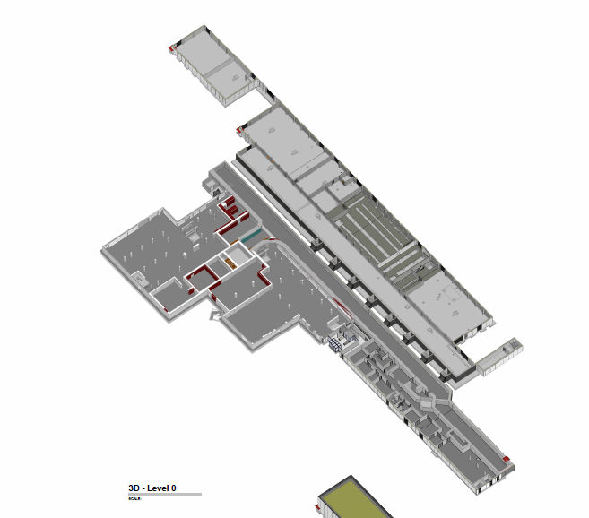
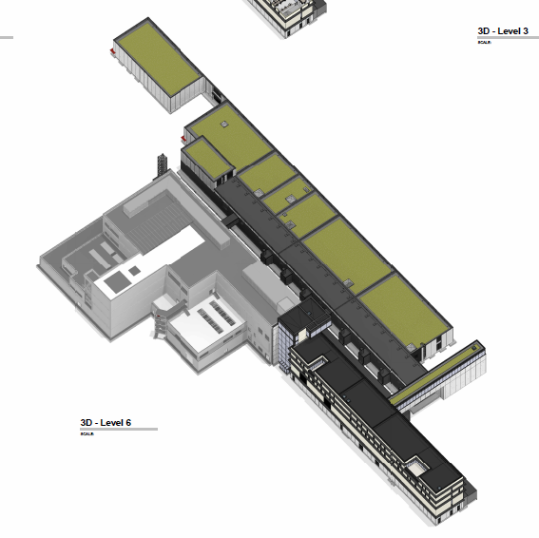
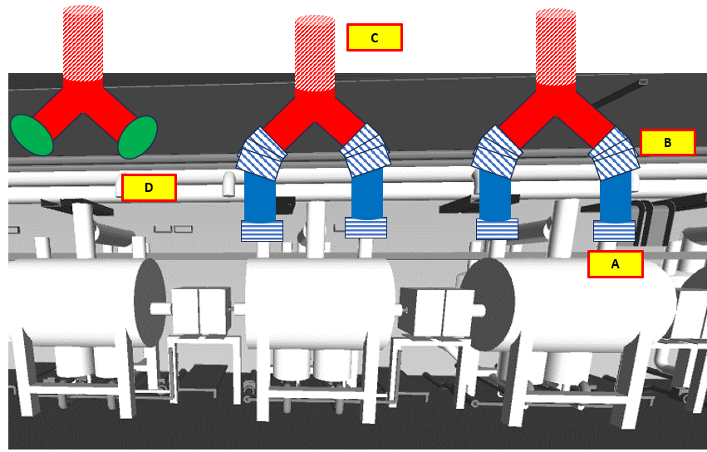
QSYS Buildings (QB_x)
SCK CEN/83474410
Buildings - Level 0
QSYS is spread across SAB1, SAB2, and LTU
QSYS has high stakes when main equipment is installed, and low stakes when it is used for routing or peripherals
High Stakes:
Main Equipment installed on premise
6
# | Building | QSYS top-level (*main) | QSYS Equipment
QB_1 | LTU/interior | QCELL* QDIST QINFRA | QM QVB QVE QLM WPS
QB_2 | LTU/Chicane | QDIST* QINFRA | QLM WPS
QB_3 | SAB2/RF-Gallery | QDIST* QINFRA | QLM WPS
QB_4 | SAB2/QRB Room | QPLANT QDIST QINFRA | QRB WPS QLM
QB_5 | SAB2/Other | QPLANT QINFRA? | WCS WPS?
QB_6 | SAB1/CCB | QPLANT QINFRA | WCS WSH
QB_7 | LTU/vents | QINFRA | WPS
QB_8 | SAB2/RF-Gallery | QCELL QDIST QINFRA | QC_int
Low Stakes:
Only peripherals or routing pipes
3
5
2
4
1
8
7

Slide 4
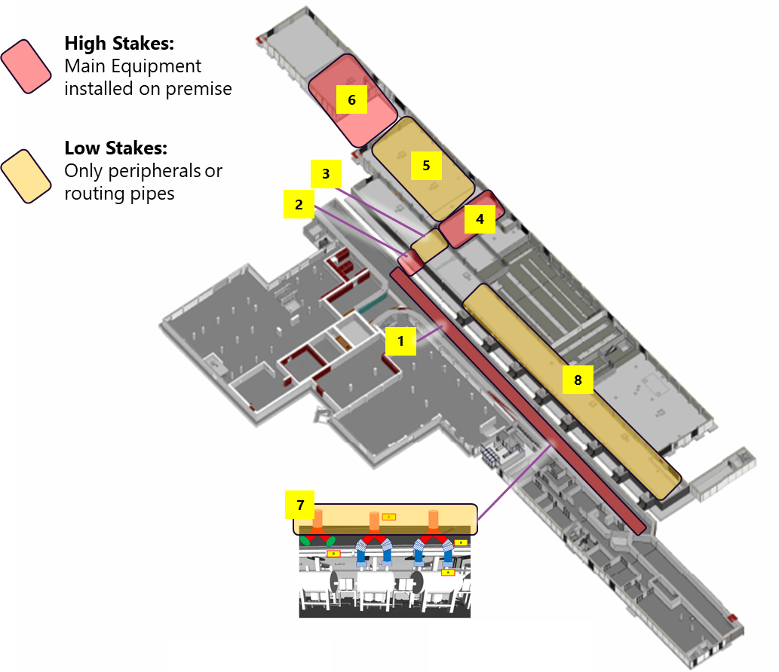
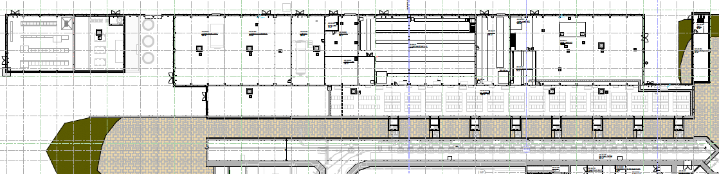
QSYS Buildings
7
=NA.BA_CDA514-Building layout NF ACC - Plan-level 0
6
5
4
3
8
2
1

Slide 5


Primary-system mnemonics (1)
ACC naming convention
X – X : X – X – ##
Full Mnemonics of the cryomodule at this particular section/sub-section:
LB-S03:CRYO-QM-01
Suffix (01-99)
Device Class (i.e. QM)
Discipline (i.e. CRYO)
The suffix “01” indicates that this is the 1st QM in the sub-section “LB-S03”. Sidenote: the LINAC has exactly one QM per section)
Sub-section (i.e. S03)
All cryomodules containing “low-beta single-spoke cavities” are of class/sub-class:
QM-LB
Section (i.e. LB)
Different types of the same device class are distinguished by their “sub-class”
X – X
Device Sub-class (i.e. LB)
Device Class (i.e. QM)
Cryo-Cell
(QCELL)
Valve box (QVB)
Storage
(NA.CP03.xSx)
Cryoplant (NA.CP01)
Cryo-distribution line (NA.CP02.QLR+QLM)
(Only Helium is used as the cooling fluid)
Cryomodule (QM)
→ each QM contains 2 cavities (CAV)
QLR
Sub-section of the low-beta LINAC (“LB-Sxx”)
Based on ACC Layout SCK/37633125 v3.0
Entrance LINAC tunnel
End-Box (NA.CP02.QVE)
QLM
Injector
LB-S30
LB-S01
0+24 QMs (current implementation)
Beam direction
To the target facilities
0+30 QMs (Full MINERVA LINAC)

Slide 6
QSYS info for the DMS

Slide 7
Status: 2nd ACC meeting 2025
Make sure all mandatory field are filled: General, Power, Cooling, Pneumatics and HVAC
→ Status set to:
‘Y’ if value is definite
‘N’ if value is preliminary
‘NA’ if Not Applicable
If a pipe/hose connection is needed for gas(+air) and/or water, 3 additional properties can be specified, using ‘Water’ and ‘Gas’ prefix:
ConnectionType: Flange or Twin ferrule tube fitting with NPT thread, ISO thread, BSPP thread, BSPT thread, SAE/MS straight thread, welding end
ConnectionDiameter: inner diameter in inches
Connector: specification in detail, so it is clear for NFS which counterpart needs to be foreseen. E.g. for cooling connections of SSA: PN40 EN 1092-1, DN 50 (Heco__FL-060-040-4)
Property Name | Data Type | Unit | Status | Value
ElementOwner | String
WindchillNo | String
InputVoltage | Float | V
InputCurrent | Float | A
EarthingTopology | String | (3)PH-N-PE
RatedElectricalInputPowerApparent | Float | VA
RatedElectricalInputPowerActive | Float | W
ActivePowerFullBeam | Float | W
CoolingWaterInletTemperatureMin | Float | degC
CoolingWaterInletTemperatureMax | Float | degC
CoolingWaterInletTemperatureFluct | Float | degC
CoolingWaterType | String
CoolingWaterInletPressureMin | Float | barg
CoolingWaterInletPressureMax | Float | barg
CoolingWaterPressureDropNom | Float | bar
CoolingWaterFlowNom | Float | l.min-1
CoolingPower | Float | W
CompressedAirInletPressureMin | Float | barg
CompressedAirInletPressureMax | Float | barg
CompressedAirInletPressureNom | Float | barg
CompressedAirVolumetricFlowRateNom | Float | m3.h-1
CompressedAirVolumetricFlowRateMax | Float | m3.h-1
VolumetricFlowRateDurationMax | Float | s
RatedHeatDissipationToWater | Float | W
RatedHeatDissipationToAir | Float | W
OperationalTemperatureMin | Float | degC
OperationalTemperatureMax | Float | degC
OperationalHumidityMin | Float | percent
OperationalHumidityMax | Float | percent
WaterConnectionType | String
WaterConnectionDiameter | Float | inch
WaterConnector | String
Still to be completed:
CRYO
Power VAC controllers
BD electronics
RFQ
CAV HVAC requirements
Deadline: End of May

Slide 8
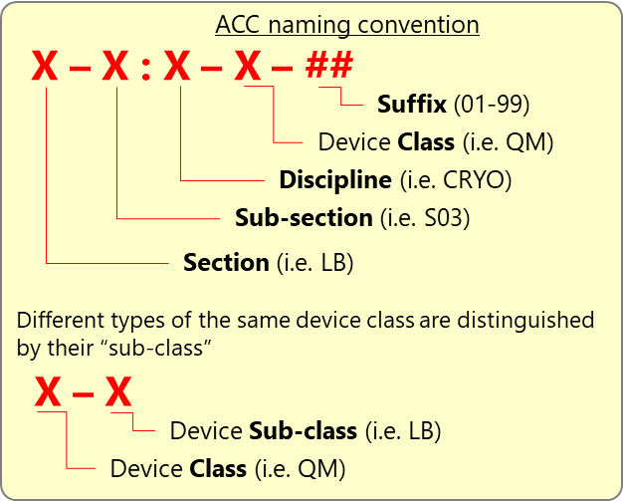
LB-Sxx:QMST-01:CV-123
LB-Sxx = the section of the linac, from 00-30
QMST-01 = the QMST component on that section. We only have 1x QMST per section, so it is always QMST-01
CV-123 = The component in question. In this case I am imposing (for now) to match our instrumentation naming convention, so we keep the numbering as we like. For the database, there is no sub-classes (tbc)
Notes
Section LB-S01 contains also the QVE
The QLM outside of LTU (chicane and AUB) will have another section (not LB-xxx)
To be clarified
Where do we put the QLM within the LTU?
LB-S01 or LB-TS? Up to Lennert to define

Slide 9
LB-Sxx:CRYO-QM-01:CV123
LB-Sxx = the section of the linac, from 00-30
CRYO-QM-01 = the QMST component on that section. We only have 1x QMST per section, so it is always QMST-01
CV123 = The component in question. In this case I am imposing (for now) to match our instrumentation naming convention, so we keep the numbering as we like. For the database, there is no sub-classes (tbc)
QM-LB-25
(instance)
LB-Sxx
CRYO-QM-01
LB-Sxx:CRYO-QM-01
TT123
Class/sub-class: TT-CX
Functional location shown on PID
Cryomodule slot

Slide 10
Cooling
HVAC
Pneumatics
Power
Cabling
WSH
tbc
WPS
tbc
WCS
QRB
QLM
QVB
QVE
QPLANT Tender Package
QMST
CAV
CAV
MGS
MGS
RFCELL scope
TUN
TUN
CPLR
CPLR
24x QCELLs

Slide 11
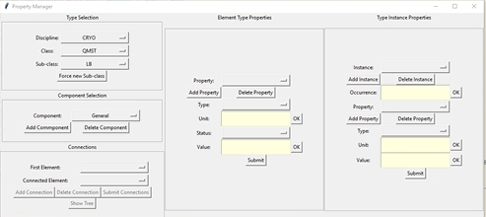
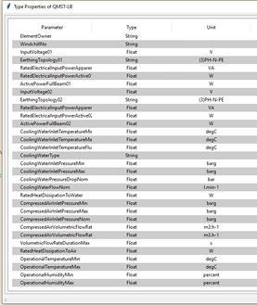
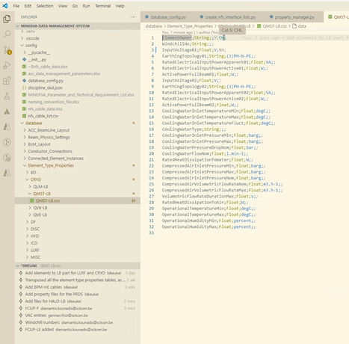

Not applicable ? Then e

Slide 12
QVB
Jumper
INVAC
Patchbox 1
AIR
Arm B
Arm A
body
QMST
Chimney
Patchbox 2
QMST

Slide 13
QMST
[element]
QMST
[element]
4x red
CV105
CV534
CV894
CV891
2x black
1x yellow

Slide 14
QMST
Later change to Q01, Q02, W01 …
For each “occurrence”
Level 1
CV
Typ1
Typ2
Typ3
Set
Read
Air
Power
Conductor 1
Conductor 2
Conductor 3
Level 2
CV-Typ2-Air-Conductor1
Level 3
CV-Typ2-Set
CV-Q02 (?)
csv file
Level 4

Slide 15
Note on utilities
Electrical power
Supplied by the cryo cabinet not by NFS
The cryo cabinet does need NFS
HVAC
Not applicable
Compressed air
Yes, valves on QMST and QVB
Water cooling
Not on QMST
Only on CPLR

Slide 16
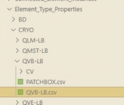
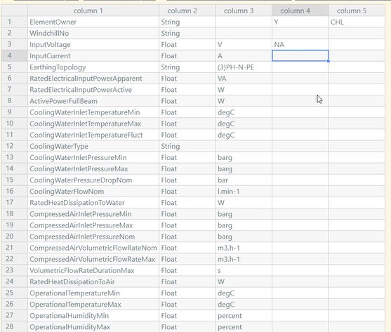

Y, NO or NA
value

Slide 17
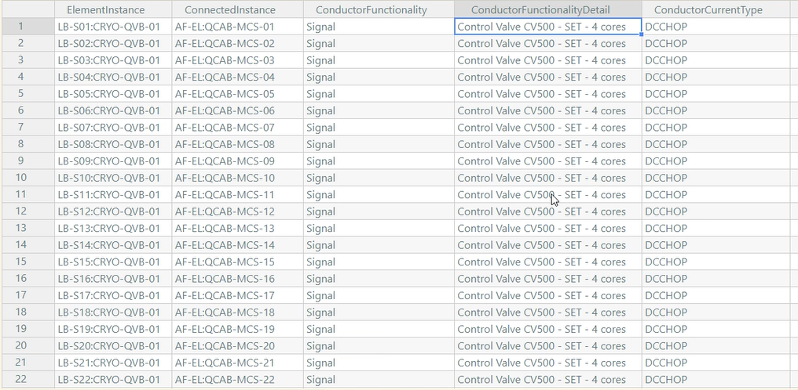
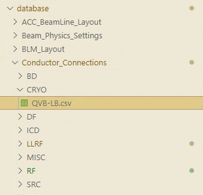
Connections of the QVB

Slide 18
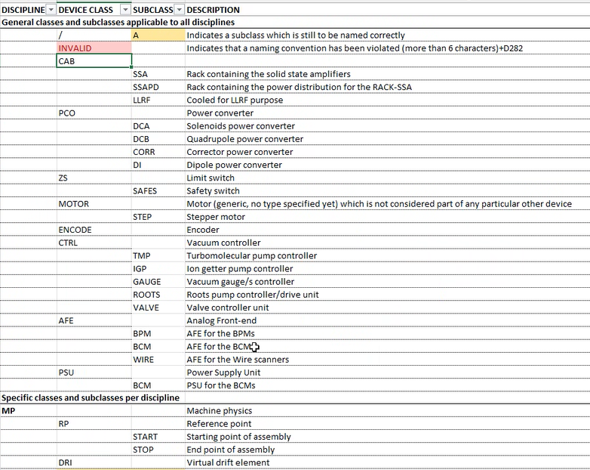
To do for mid-March release (15th)
QVB and QM element level
HVAC
Power
Water
Compressed
Cable list for QM and QVB
Handling of over-instrumentation
About the cabinet

Slide 19
Use cases
Cables
Tag

Slide 20
